Slide 1

UI5 Workshop
Michael Graf, SAP
June 12th, 2019

Slide 2


Agenda
Intro
What’s New
UI5 Evolution
Evolved Best Practices
UI5 Web Components
Fiori 3
HandsOn
Coding exercises
Q&A

Slide 3
Intro

Slide 4





SAPUI5 is an HTML5 framework designed to build cross-platform, responsive, enterprise-grade applications.
It implements the award-winning SAP Fiori Design and is the leading UI technology of SAP’s user experience strategy.
The core and many parts of the framework are open-sourced as OpenUI5. It embraces web standards and open tooling.

Slide 5


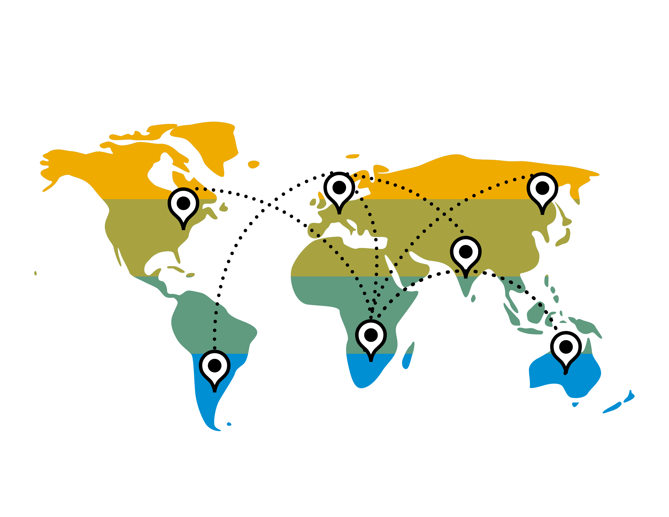


Product Portfolio
SAP Web IDE
UI theme designer
SAP Build
UI5 support assistant
UI5 inspector
UI5 Tooling
Tools
SAP Fiori
SAP S/4HANA
SAP Business Suite
Products
SAP SuccessFactors
SAP SaaS solutions
SAP Cloud Platform
SAP NetWeaver ABAP/Java
SAP HANA XSA
CDN/Akamai
GitHub (OpenUI5)
Local download
Distribution
Platforms
Windows, macOS, iOS, Android
SAP Fiori Client
IE 11, Microsoft Edge, Chrome, Firefox, Safari
Web view
SAPUI5 Demo Kit
SAP training
openSAP
SAP Community
Stack Overflow
Slack
Knowledge

Slide 6



Key Capabilities
The core serves as foundation and simplifies web development. All parts of the core are open-sourced and used in both SAPUI5 and OpenUI5.
SAPUI5 offers ready-to-use UI controls, ranging from basic elements to complex UI patterns. Apps benefit from a consistent design language and coherent UX patterns. Many of them are also delivered as part of OpenUI5.
With SAPUI5 flexibility different user can flexibly adapt applications.
Various tools complement the framework of both SAPUI5 and OpenUI5. They assist in building and testing apps as well as diagnosing and resolving issues.
Application UI
SAPUI5 tools
Support tools
SAP Fiori elements
Mixed app
Freestyle app
SAPUI5 flexibility
SAPUI5 control libraries
App templates
SAP Fiori elements
Smart controls
Demo Kit
Regular controls
SAPUI5 core
Programming model
Security, globalization, accessibility, . . .
Components, MVC, data binding, . . .
Back-end clients (OData, JSON, XML)

Slide 7
Freestyle Development vs. SAP Fiori Elements
Efficiency
Flexibility
SAP Fiori elements
Mix
Manual coding
Freestyle
Smart Controls
Regular Controls
Business data (SAP Gateway / OData)
Semantic meta data (OData annotations)

Slide 8
Whats New

Slide 9
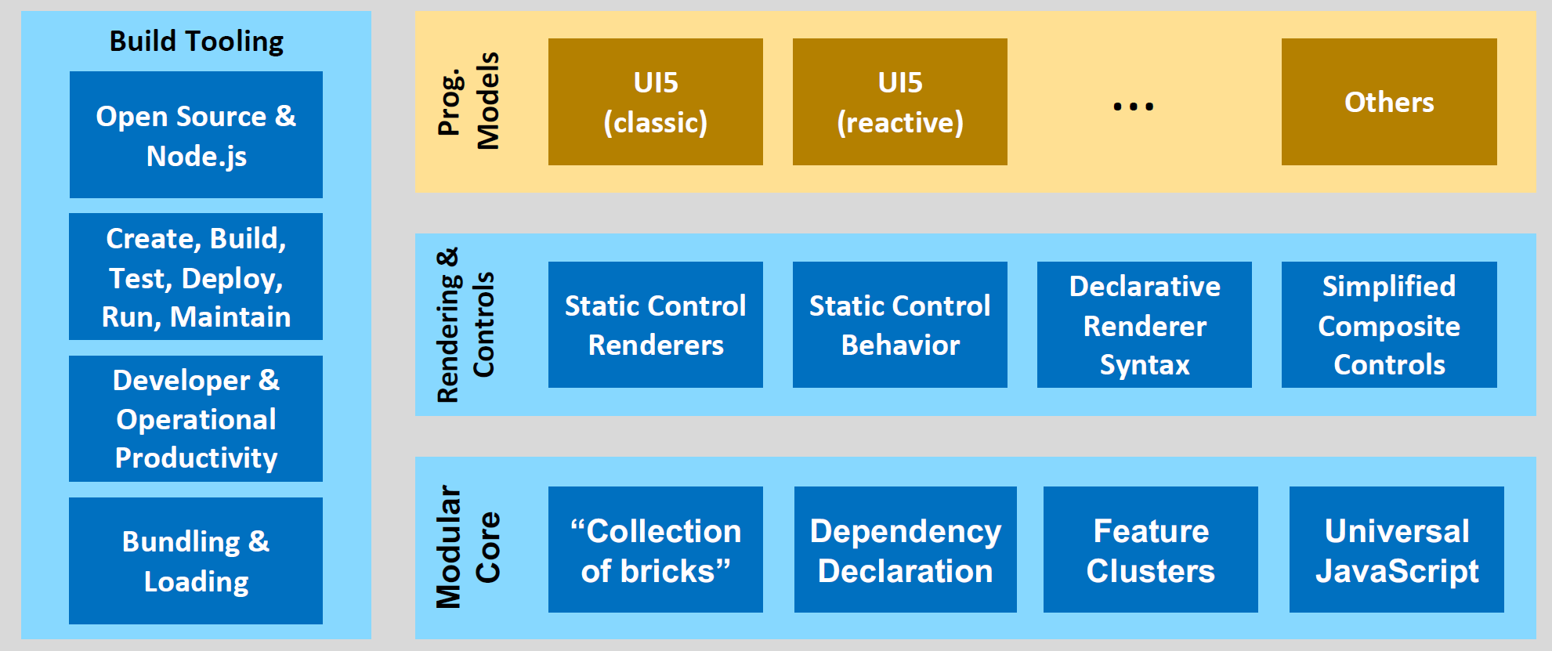
Perfor-mance
UI5 Evolution
Compa-tibility
Modular-ization
Learn more…
Openness
Standards & Trends

Slide 10
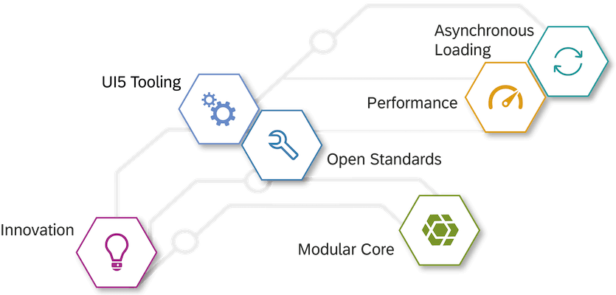
All Things Async!
Evolved Best Practices
Use new APIs
Learn more…
Use new build and test tools!
Avoid jQuery!
No more globals!
No JavaScript in HTML

Slide 11
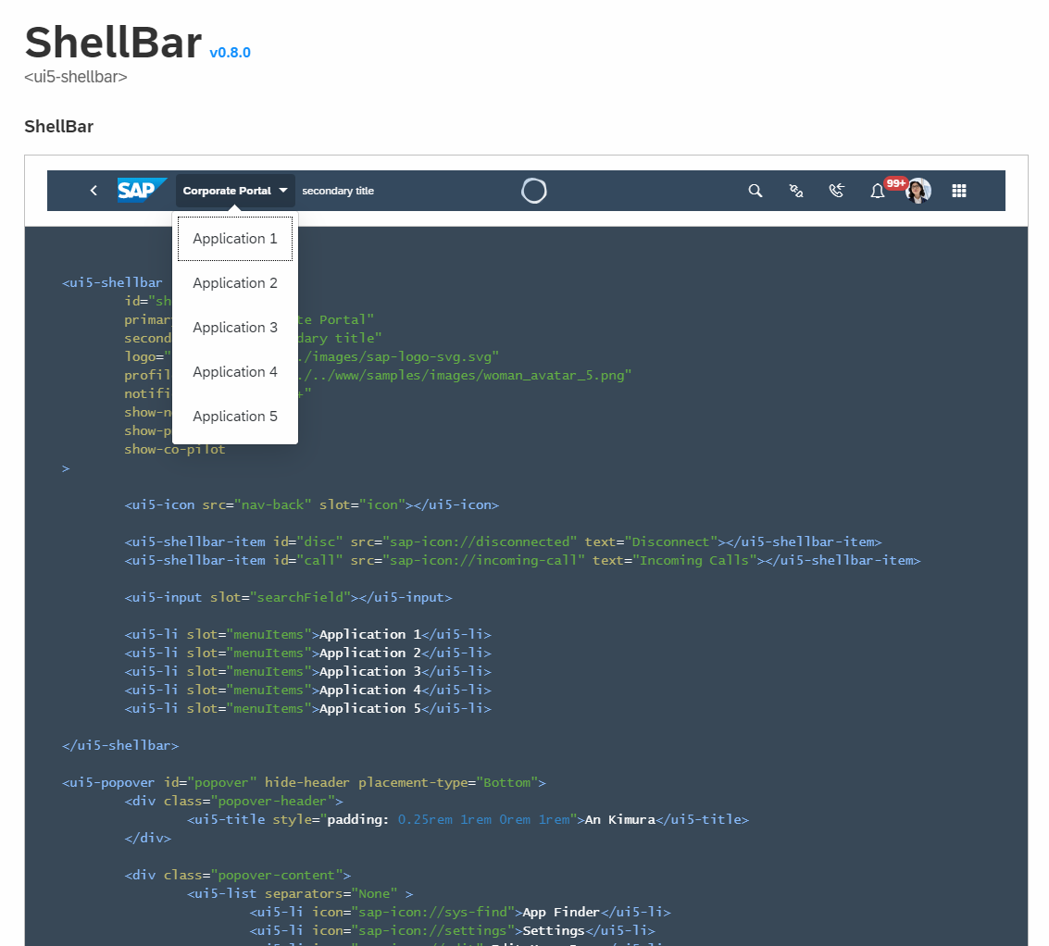
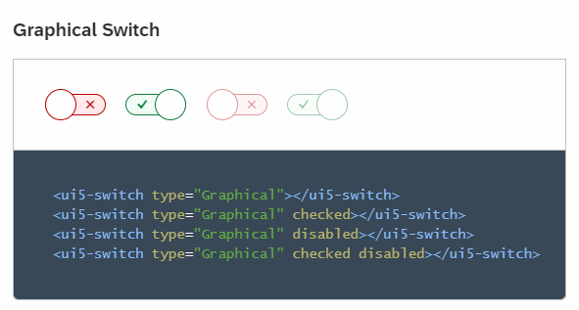
UI5 Web Components
Learn more…
UI5 Web Components

Slide 12
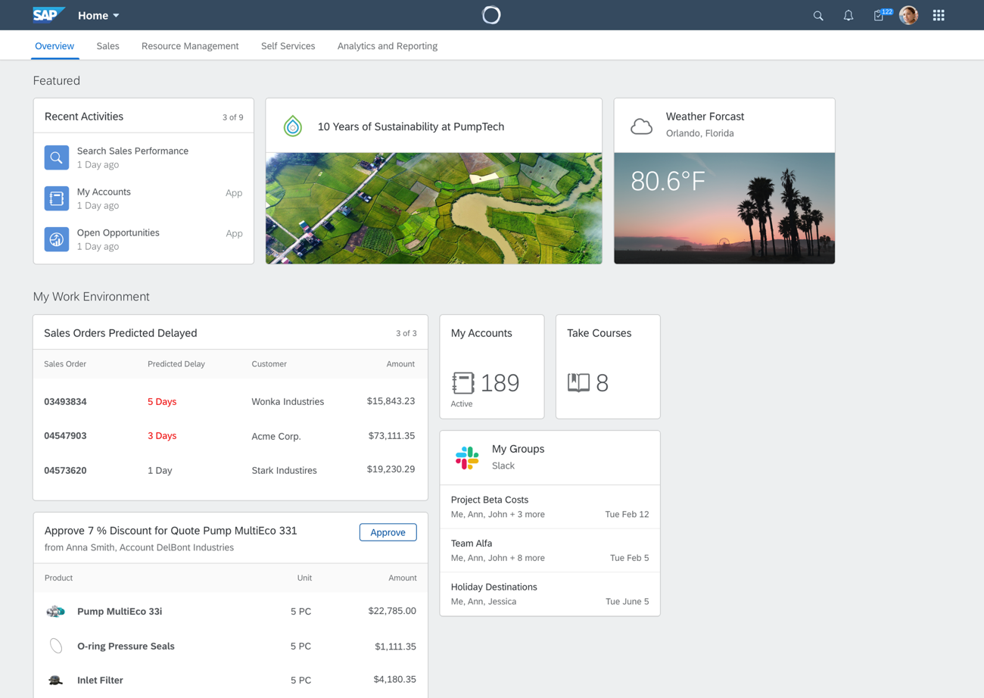
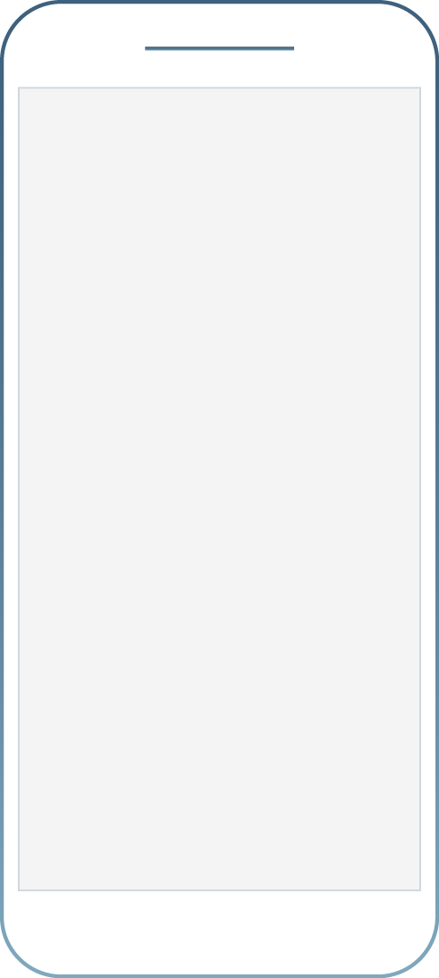
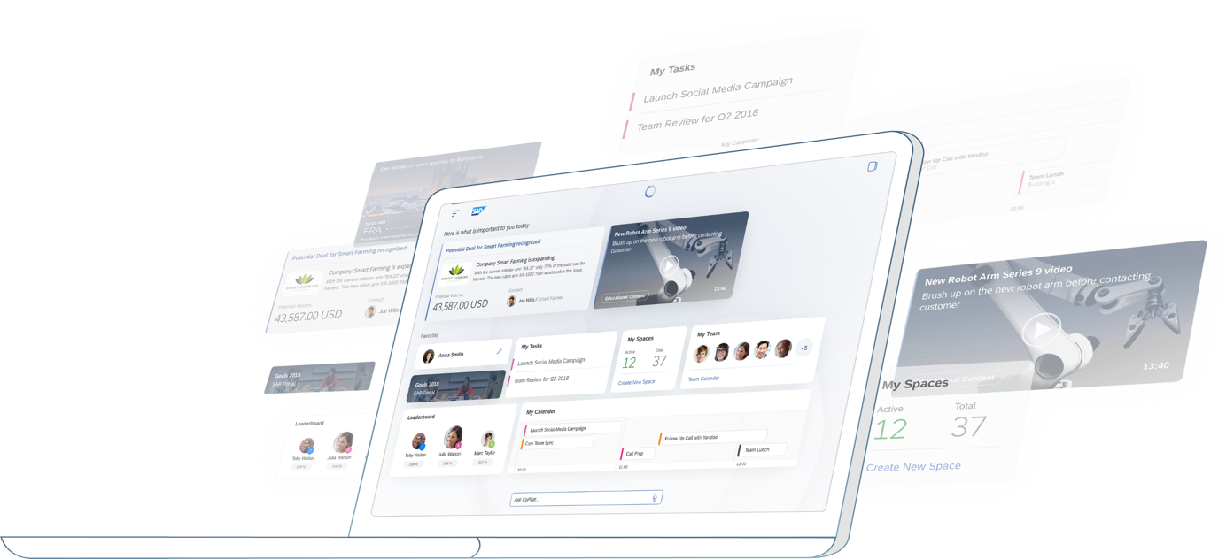
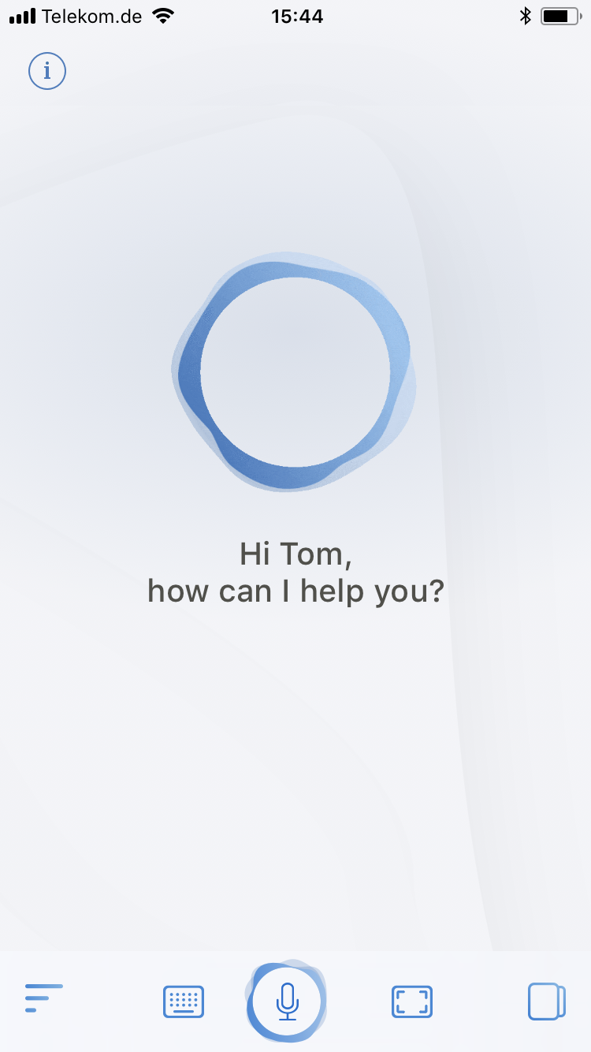
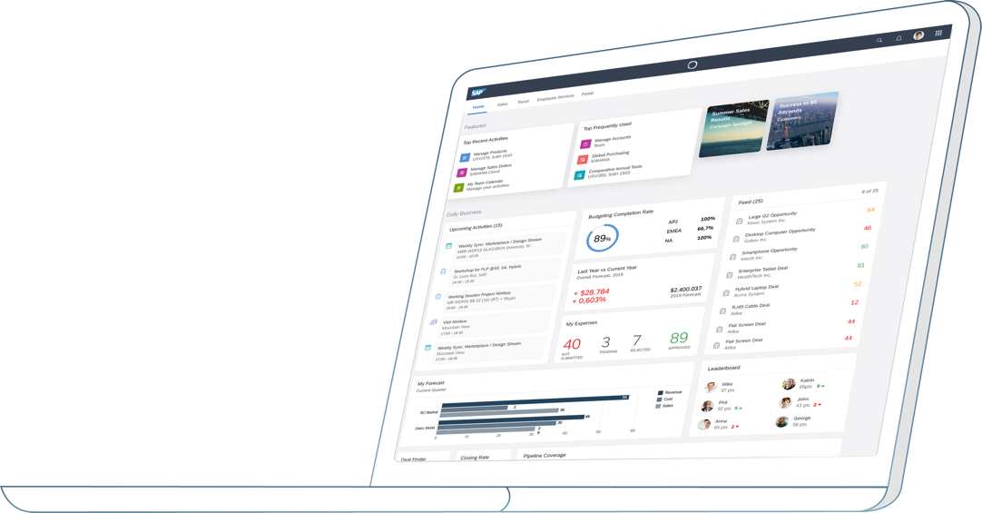
Fiori 3
Learn more...

Slide 13
Hands On

Slide 14




Choose Your Flavor
Setup:
Create ES5 user Import ES5 destination
Clone Repo
Switch to branch „start“
New Web IDE Tools
New Fiori 3 Controls
New XML Composites

Slide 15
Q&A

Slide 16


Thank you.
Contact information:
Michael Graf
SAP SE
mi.graf@sap.com
@michadelics
https://github.com/michadelic
Learn UI5: https://open.sap.com/courses/ui52

